Slide 1




Micronet
HEAD OFFICE:
Micronet Solutions
# Plot No. 80 K T Nagar, Katol Road
Nagpur-440013
Mob.: 9422104111 | 8446563560
info@micronetsolutions.in

Slide 2
HEAD OFFICE:
Micronet Solutions
# Plot No. 80 K T Nagar, Katol Road
Nagpur-440013
Mob.: 9422104111 | 8446563560
info@micronetsolutions.in

Slide 3
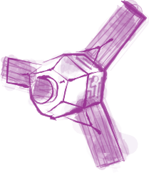
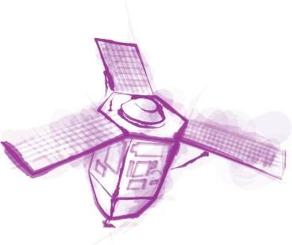
01 -- About Our Brochure
02 -- About Our Company
03 -- About Our Partners
04 -- Industries We Served
05 -- Products
06 -- Services
01

Slide 4





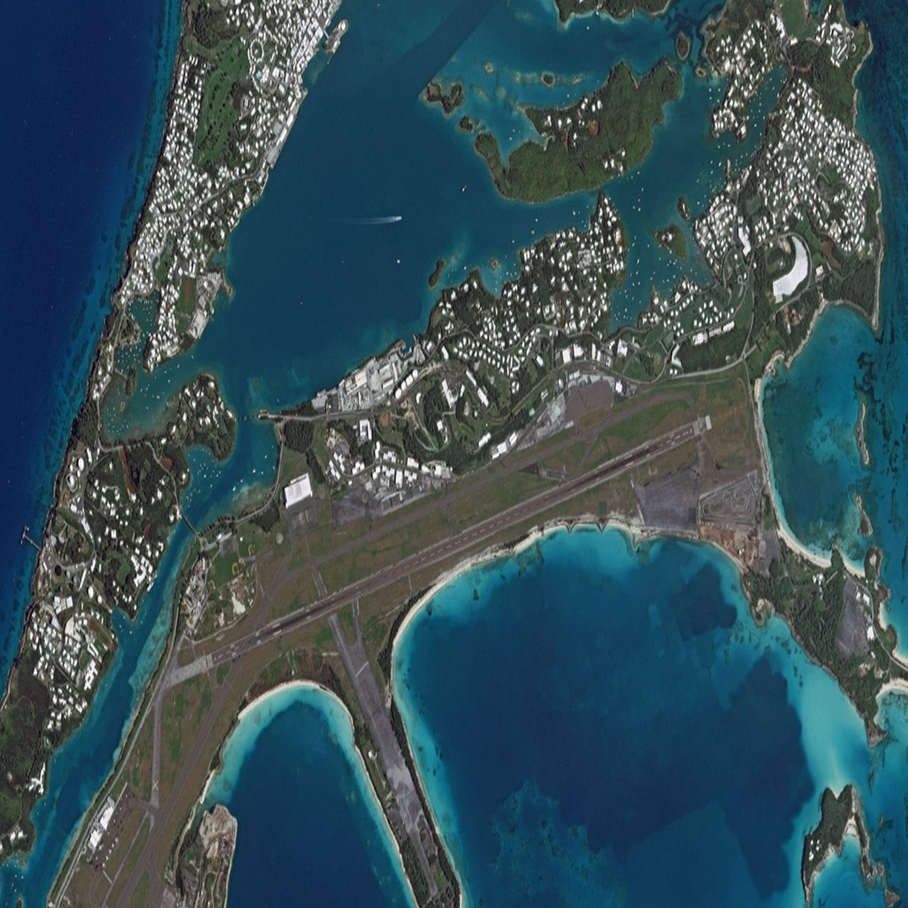
ABOUT OUR COMPANY
We have 15 years of experience in dealing and implementing projects for Various central & State government agencies. Micronet Solutions has line production facilities to handle large volumes of spatial data ensuring timely deliverables and quality outputs. Simplying complex problems for geo-spatial database creation and ensuring industry standard quality benchmarks are our forte.We are authorized Distributors of Airbus Defence and Space (France) for india and Planet labs marketing partner.
02

Slide 5



OUR PARTNERS
Airbus Defence & Space (Airbus DS) has been a leading provider of satellite imagery for more than three decades. The Europe-headquartered company operates the largest constellation of optical and radar commercial earth observation satellites available in the market today.
MDA Canadian space technology company MDA delivers world class satellite systems and operational geospatial intelligence systems, amongst many offerings. Through its RADARSAT-2 program, MDA offers reliable, near-real-time access to all-weather imagery and surveillance information.
Planet Labs Leading the way in global daily satellite imagery, American earth imaging company Planet Labs is driven by a mission to make global change accessible and actionable through daily monitoring. The company’s fleet of over 200 earth imaging satellites collects over 350 million square meter of earth land mass imagery daily.
03

Slide 6




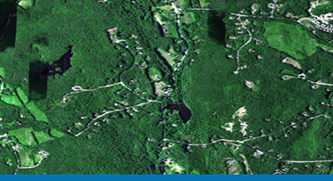
INDUSTRIES WE SERVED
Agriculture
Crop identification & Monitoring, Crop health and Monitoring
Crop yield Estimation, Crop rotation Monitoring, Crop Damage
Estimation, Field activity, Soil Moisture.
Defence & Security
Strategic, tactical and operations, Combat missions
Route planning, Training and simulations, Air, sea, and land navigation, Command, control, communications, and intelligence operations, Modeling and simulation.
Forestry and Environment
Mapping of crown density for reserve forests
Identification of potential sites for afforestation purpose
Creation of baseline information for forest and wastelands management
04

Slide 7
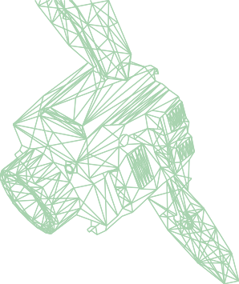
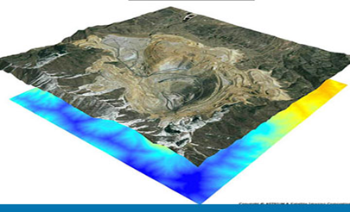
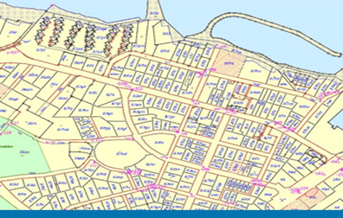

Mining & Mineral Monitoring
Change Detection Services, Volumetric Changes
Cadastral Mapping and Urban Mapping
Water Pipeline Networks, Sewage, Networks, Electrical Networks, Road Transportions
Oil and Gas
Detect seismic lines and well locations, Document persistent offshore oil seepage, Map rock formations, elevation, and major structures, Update coordinates of old well locations, Differentiate major rock types, Identify barren and productive basin areas, Perform noninvasive mapping to preserved areas
05

Slide 8
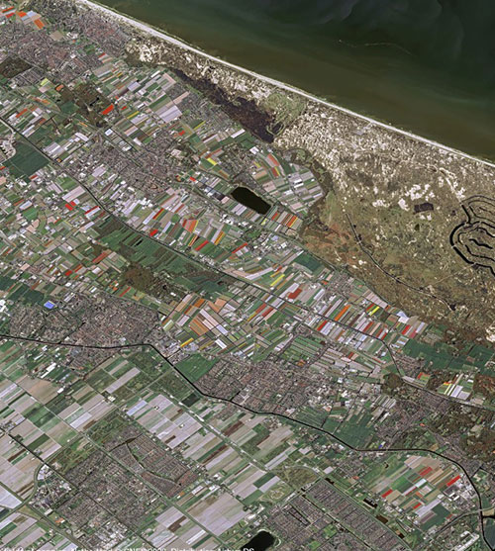
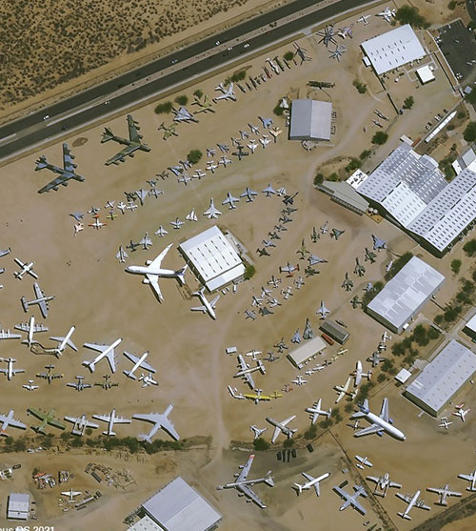
PRODUCTS
Sample the world class imagery and data solutions provided by our partners.
PLEIADES
Very-high resolution satellite imagery to note details. The identical satellites of Airbus, Pléiades 1A and Pléiades 1B deliver 50cm optical imagery in record time.
PLEIADES NEO
Very-high resolution optical imagery for an unprecedented level of geospatial services. Features four identical 30cm resolution satellites and optimises each step of the satellite acquisition and delivery cycle.
06

Slide 9
PLANET BASEMAPS
Visually consistent and science-grade mosaics that enable time-series analysis and machine learning-powered analytics. Planet Basemaps leverage cutting-edge software together with daily global satellite imagery.
RADARSAT
Synthetic aperture radar (SAR)-based reliable, near-real-time access to all-weather imagery and surveillance information, producing over 75,000 images per year.
07

Slide 10
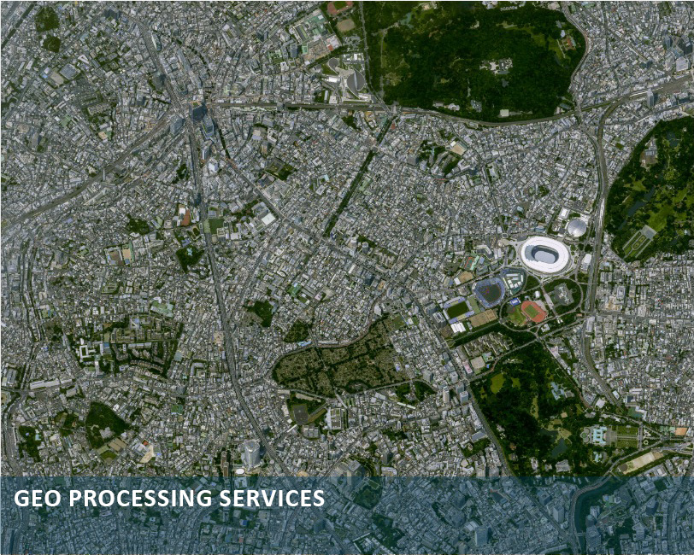
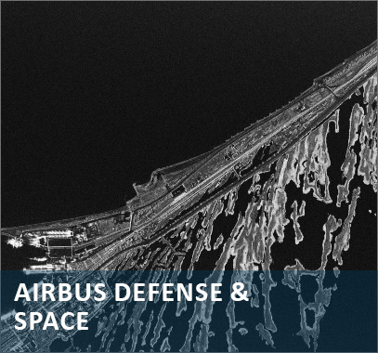
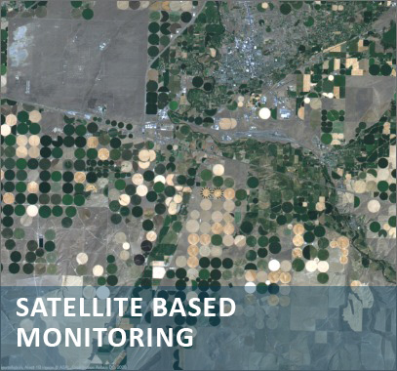
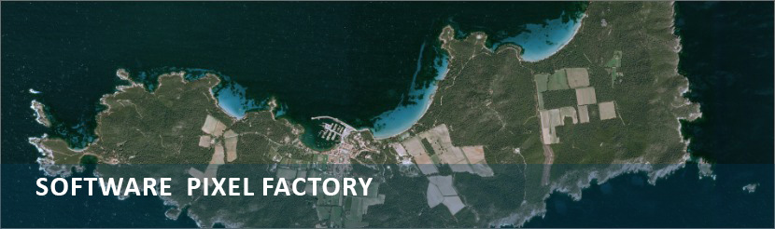
SERVICES
We are committed to providing the most value to our clients in addition to providing remote sensing data. We provide a host of services to help our clients in improved interpretation and optimization of their use of satellite and other spatial data.
Our services include GIS services, digital photogrammetry, 3D modelling, digitization, image processing, DGPS surveys, consulting, map publication.
08

Slide 11
